Slide 1
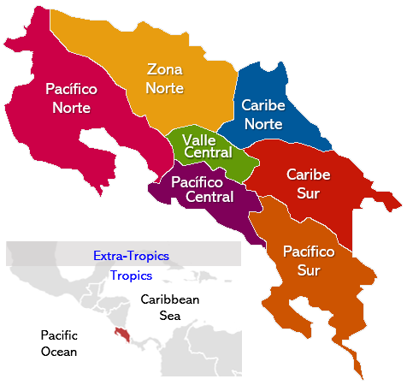
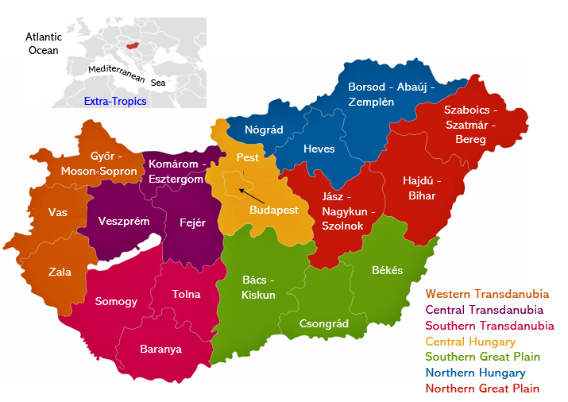
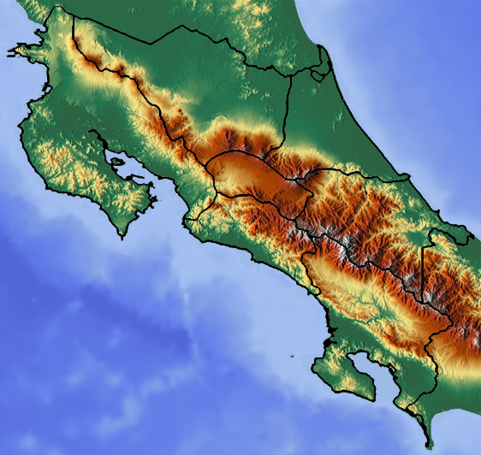
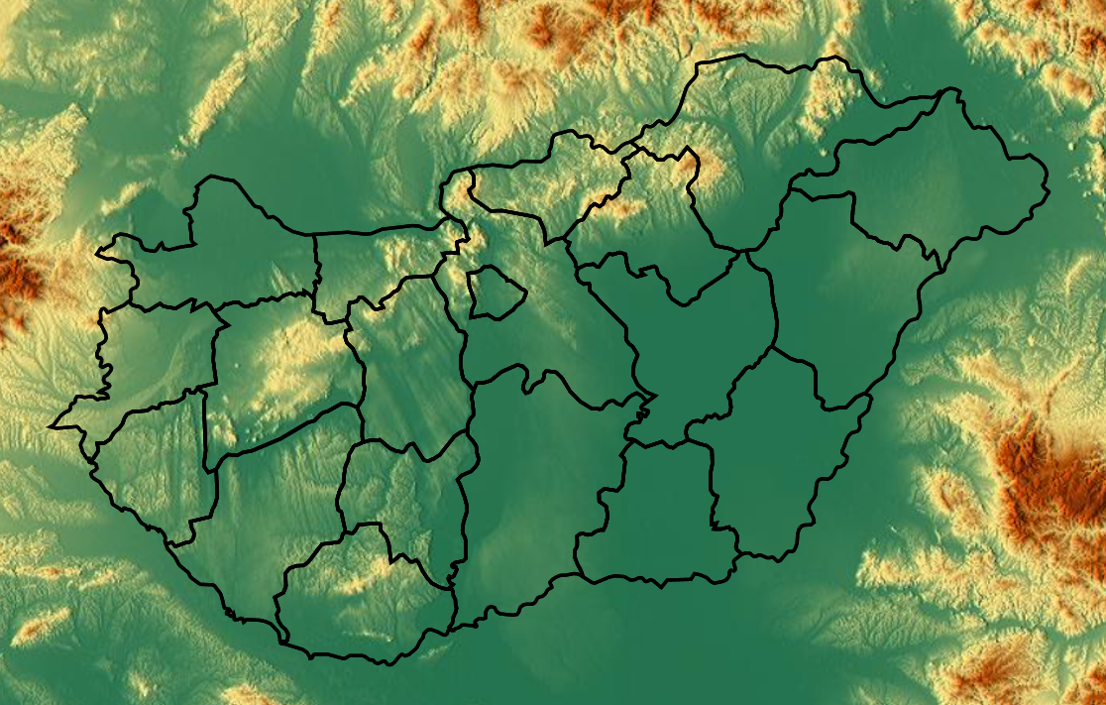
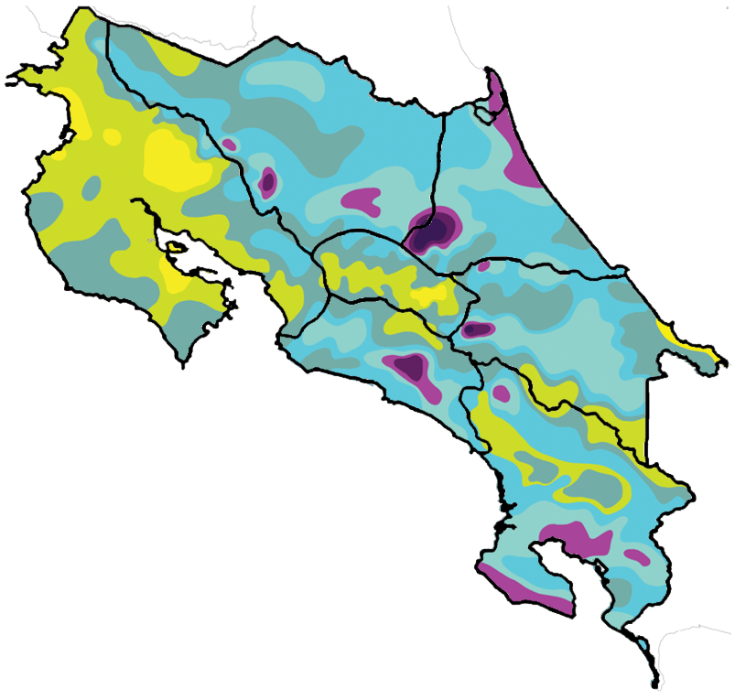
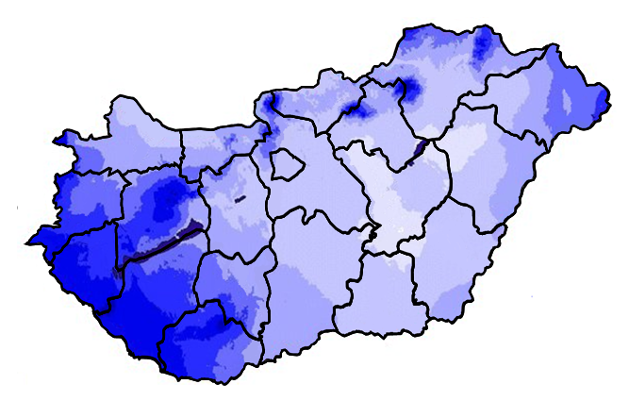

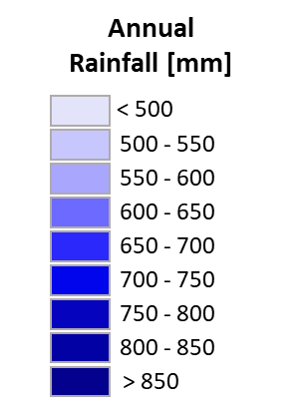
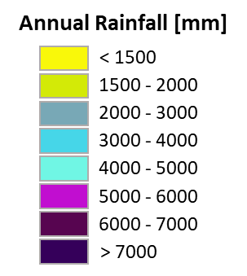

Climatological Regions
a
b
Administrative Counties
Administrative Regions
9000
5000
3000
2000
1000
0
m a.s.l.
Nicoya Peninsula
c
d
e
f

Slide 2
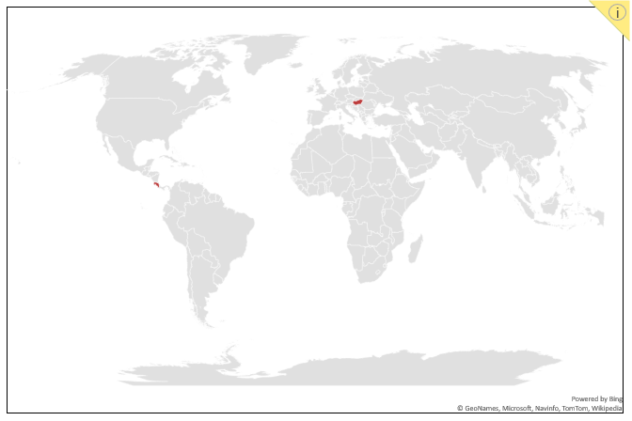

Slide 3

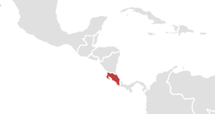
Zona Norte
Pacífico Norte
Caribe Norte
Valle
Central
Pacífico
Caribe
Sur
Central
Extra-Tropics
Pacífico Sur
Tropics
Caribbean
Sea
Pacific
Ocean

Slide 4
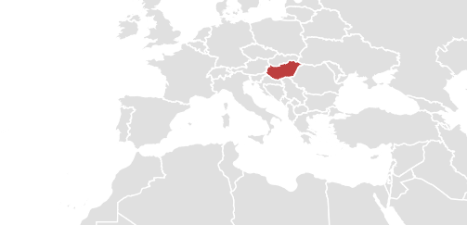
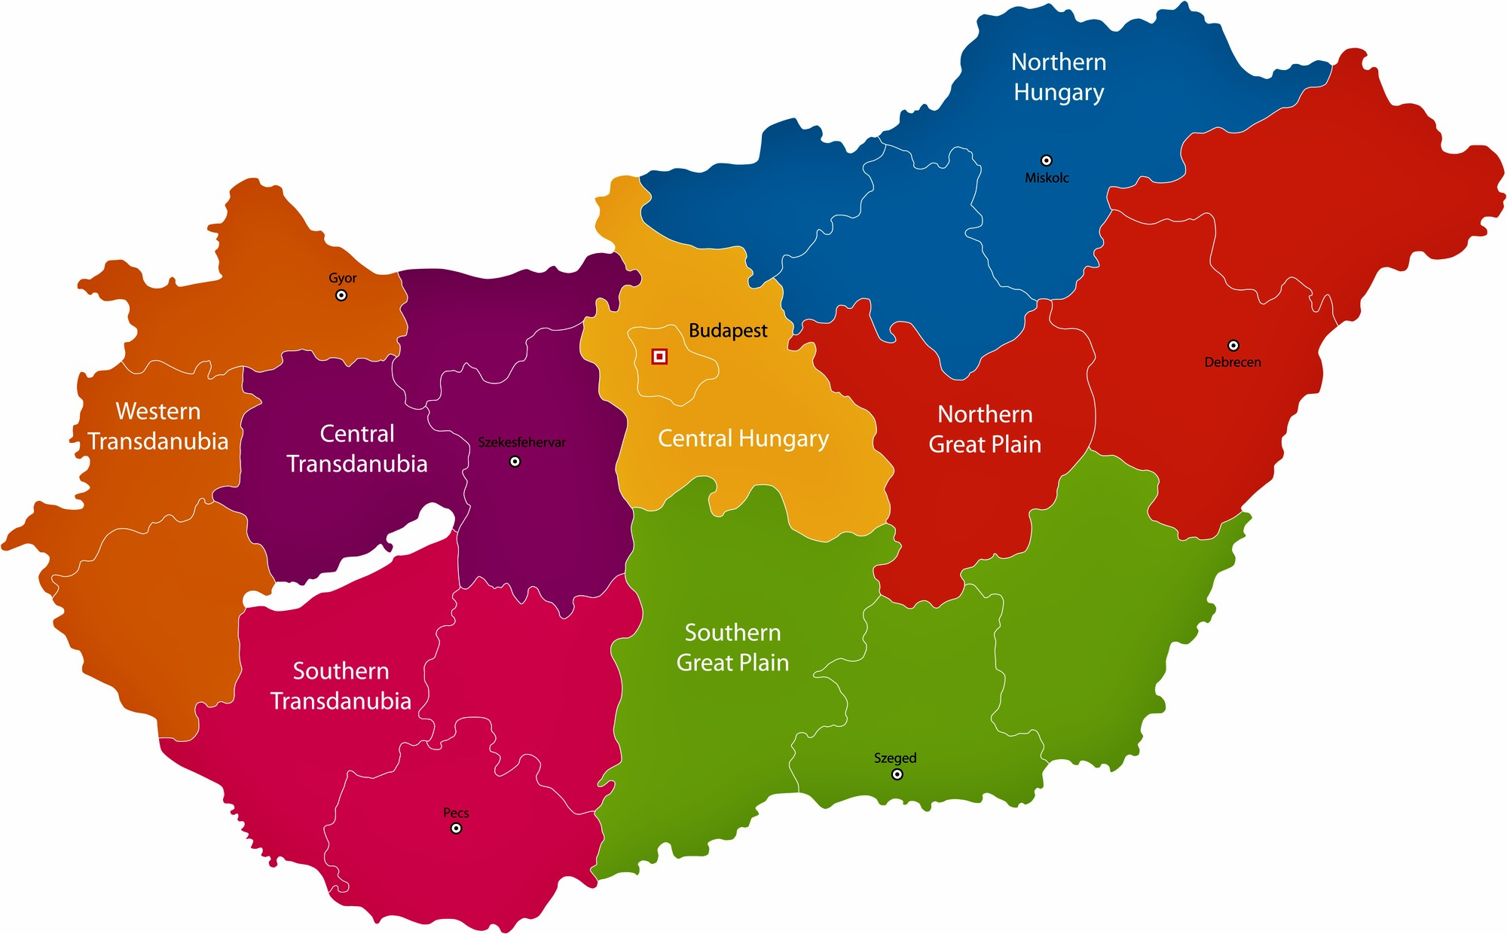
Atlantic
Ocean
ite
Med
rran
ean
Sea
Borsod - Abaúj - Zemplén
Extra-Tropics
Szaboics -Szatmár - Bereg
Nógrád
Győr -
Moson-Sopron
Pest
Heves
Komárom -Esztergom
Hajdú - Bihar
Jász -Nagykun -Szolnok
Vas
Veszprém
Fejér
Budapest
Zala
Bács -
Kiskun
Békés
Somogy
Tolna
Western Transdanubia
Central Transdanubia
Southern Transdanubia
Central Hungary
Southern Great Plain
Northern Hungary
Northern Great Plain
Csongrád
Baranya

Slide 5
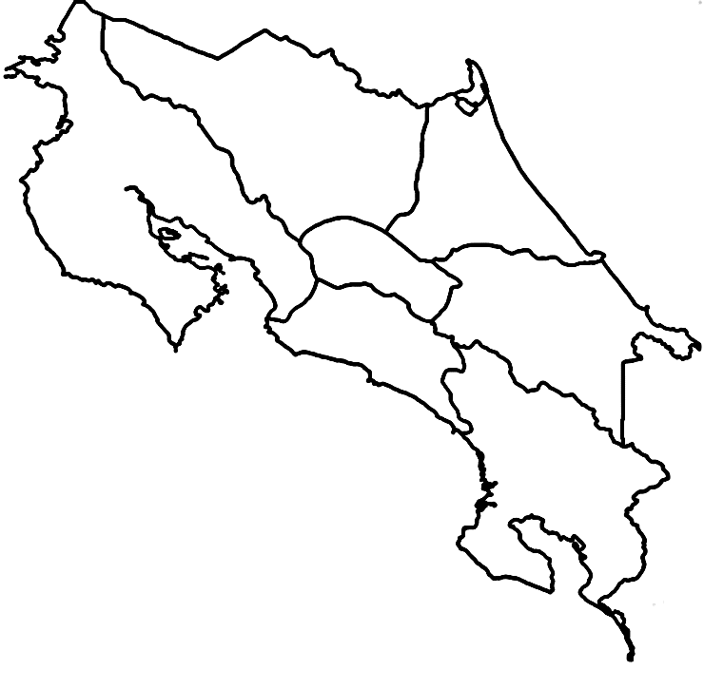

Slide 6


Slide 7
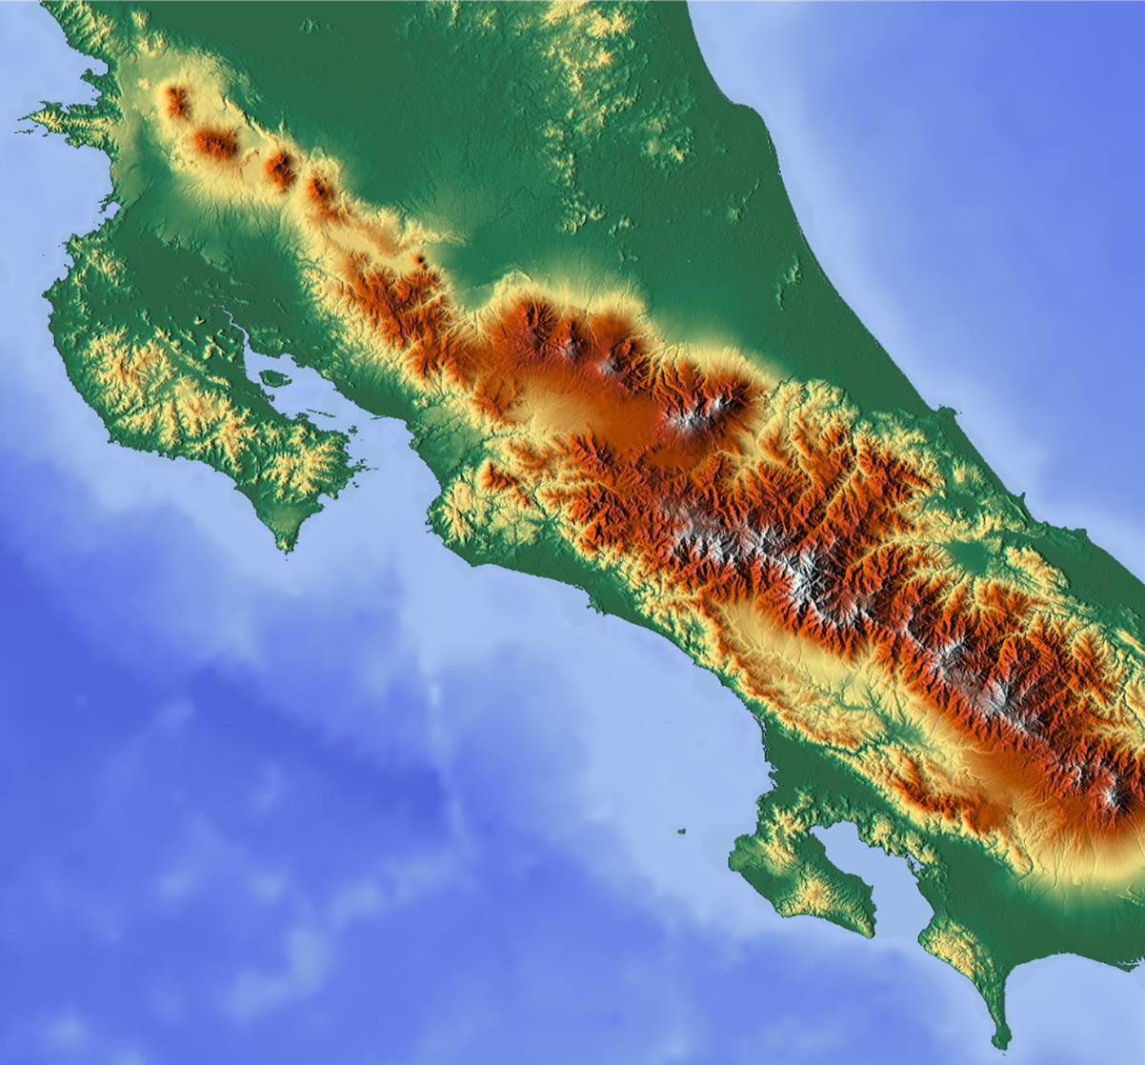
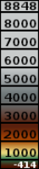
m.a.s.l.

Slide 8
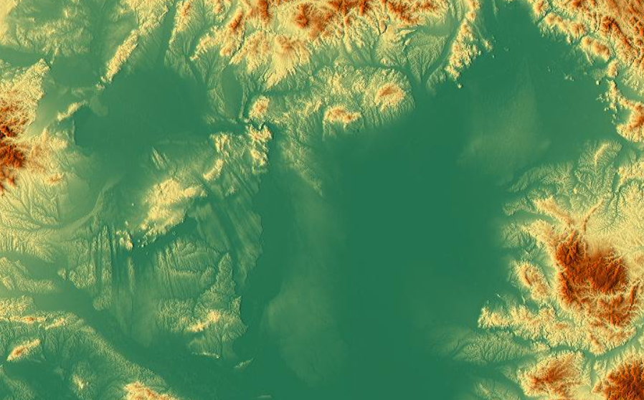


Slide 9
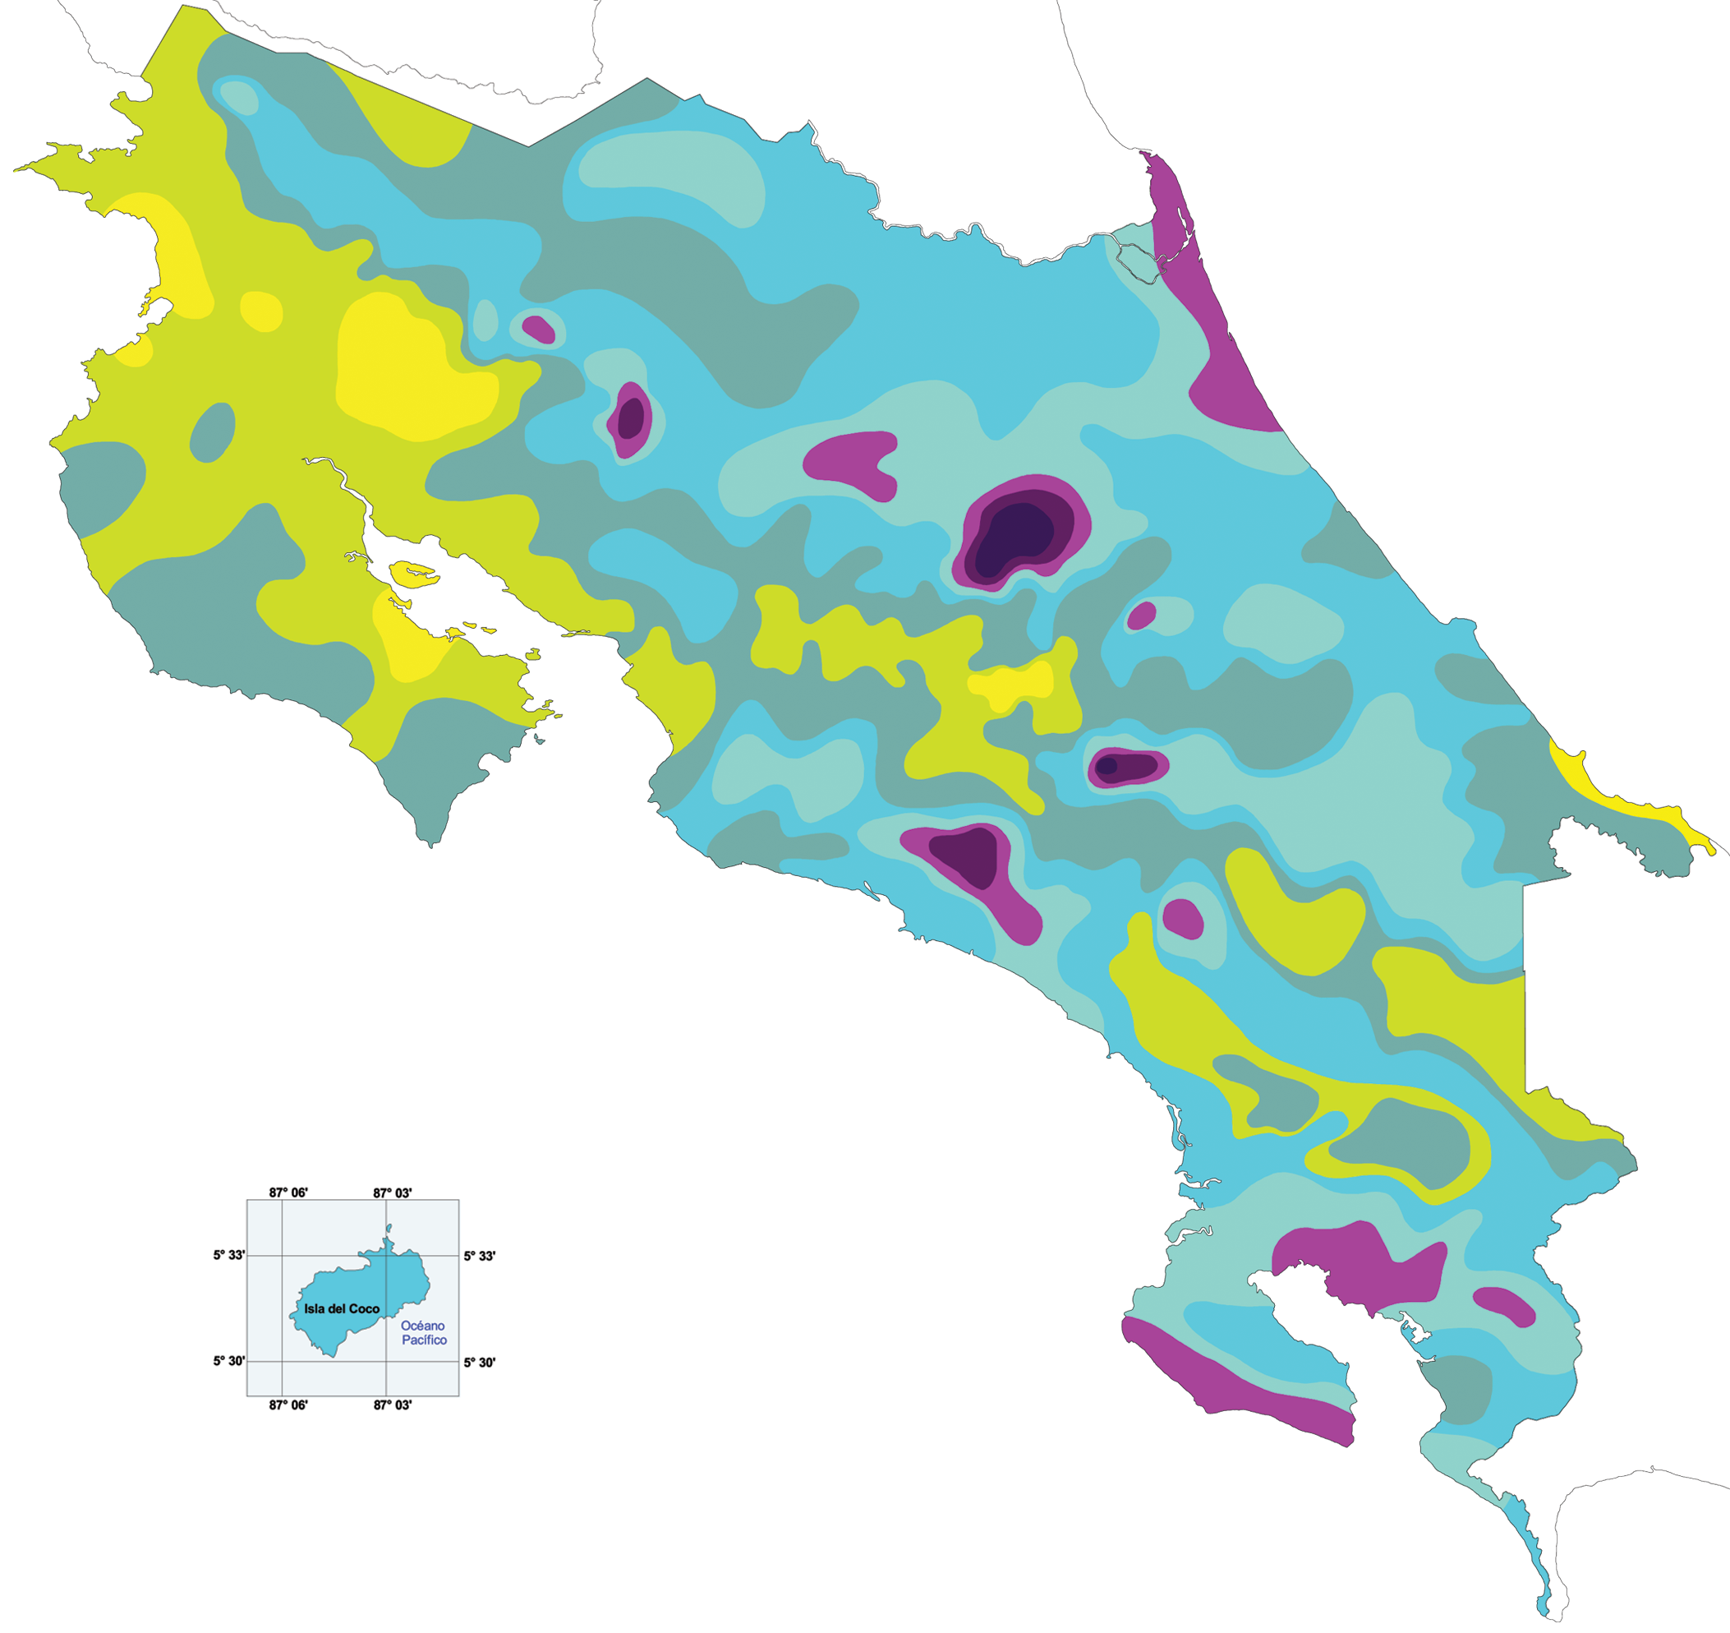
Annual Rainfall [mm]
< 1500
1500 - 2000
2000 - 3000
3000 - 4000
4000 - 5000
5000 - 6000
6000 - 7000
> 7000

Slide 10
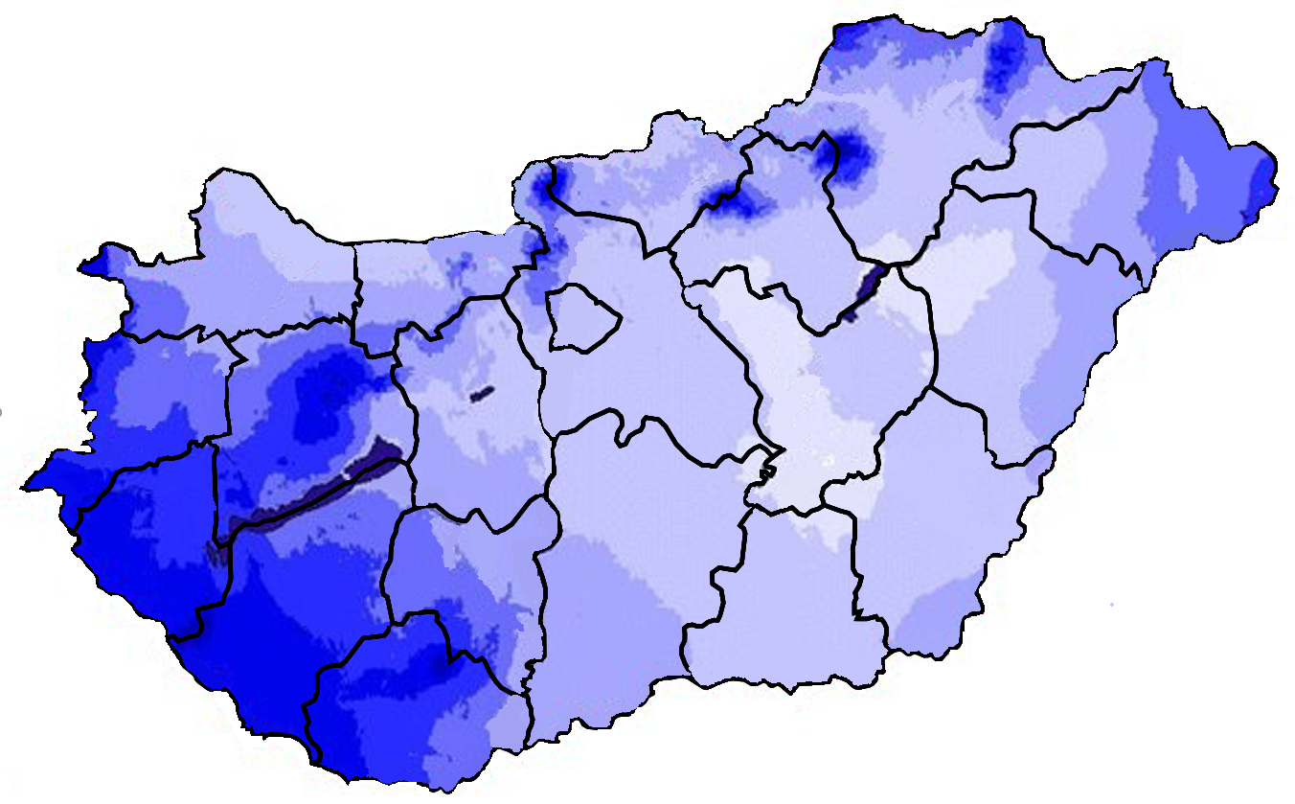
Annual
Rainfall [mm]
< 500
500 - 550
550 - 600
600 - 650
650 - 700
700 - 750
750 - 800
800 - 850
> 850

